Slide 1
Advanced Deep Learning
ZG513
Prepared by Dr. Sugata Ghosal and notes by Aakash Goel
Notes:
We’re learning how to replace many raw variables with a few informative summaries.
Example: 200 CAN/telematics features → 10 components representing ‘drive style’, ‘load’, ‘thermal regime’, and ‘road roughness’. Then cluster vehicles or detect anomalies.
Engage: Quick ask: In your work, what is the ‘latent thing’ you wish you could measure directly—quality, health, stress, or driver behavior?

Slide 2
Session Content
Factor Analysis
Principal Component Analysis (PCA)
    Randomized PCA
    Incremental PCA
    Kernel PCA
Independent Component Analysis (ICA)
Canonical Correlation Analysis (CCA)
Locally Linear Embeddings (LLE)
Reading: R1: Hands-On Machine Learning …, Chapter 8
Notes:
We’re learning how to replace many raw variables with a few informative summaries.
Imagine you’re looking at a vehicle with 300 dials on the dashboard. No driver can use that.
Factor/component analysis builds a new dashboard with maybe 5–20 needles that summarize the car’s state.
Those needles are weighted mixes of many sensors—so the ‘needle’ moves when the underlying phenomenon changes.

Slide 3
Cocktail-party Problem
Multiple sound sources in room (independent)
Multiple sensors receiving signals which are mixture of original signals
Estimate original source signals from mixture of received signals
Can be viewed as Blind-Source Separation as mixing parameters are not known
Notes:
Multiple sound sources in room (independent)
Concept/Gist: ICA separates mixed signals into statistically independent sources.
Example: Sensors capture mixtures of engine harmonics + road input + gearbox resonance; ICA helps separate these sources for diagnosis.
Engage: Quick ask: What independent sources could be mixing in your signals (engine/road/noise/sensor drift)?
Transition: ‘Cocktail party or Blind Source Separation (BSS) problem’ — we keep the same theme: replace many raw dimensions with a few informative ones.

Slide 4
BSS and ICA
Cocktail party or Blind Source Separation (BSS) problem
  Ill posed problem, unless assumptions are made!
Most common assumption is that source signals are statistically independent. This means knowing value of one of them gives no information about the other.
Methods based on this assumption are called Independent Component Analysis methods
  statistical techniques for decomposing a complex data set into independent parts.
It can be shown that under some reasonable conditions, if the ICA assumption holds, then the source signals can be recovered up to permutation and scaling.
Notes:
ICA separates mixed signals into statistically independent sources.
Think of multiple speakers in a room: each mic records a mixture. ICA tries to unmix.
In vehicles, sensors often measure mixtures too—road + engine + drivetrain + sensor noise.
ICA works when sources are independent and non-Gaussian; then it can recover them up to scaling and order.
Transition: ‘Source Separation Using ICA’ — we keep the same theme: replace many raw dimensions with a few informative ones.

Slide 5
Source Separation Using ICA
Microphone 1
Separation 1
W11
+
W21
W12
Microphone 2
Separation 2
W22
+

Slide 6
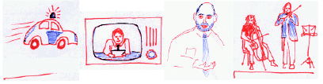

The ICA model
s₁
s₃
s₄
s₂
x_{i}(t) = a_{i1}*s₁(t) +
a_{i2}*s₂(t) +
a_{i3}*s₃(t) +
a_{i4}*s₄(t)
Here, i=1:4.
In vector-matrix notation, and dropping index t, this is
x = A * s
a₁₂
a₁₃
a₁₁
a₁₄
x₁
x₂
x₃
x₄
Notes:
s1​(t),s2​(t),s3​(t),s4​(t) These are the true underlying signals you want to recover.
x1​(t),x2​(t),x3​(t),x4​(t) These are the signals you actually record from sensors/microphones. These are mixtures of the sources.
aij​ These numbers tell you how much source $s_{j}$contributes to sensor $x_{i}$. Example meaning: $a_{12}$= contribution of $s_{2}$into $x_{1}$
Each observed signal $x_{i}\left(t\right)$is a weighted sum of all the hidden sources $s_{1}\left(t\right)$to $s_{4}\left(t\right)$. The weights are $a_{ij}$. So every sensor hears a mixture — not a pure source

Slide 7
BSS
Problem: Determine the source signals s, given only the mixtures x.
If we knew the mixing parameters a_{ij} then we would just need to solve a linear system of equations.
We know neither a_{ij} nor s_{i}.
ICA was initially developed to deal with problems closely related to the cocktail party problem
Later it became evident that ICA has many other applications
  e.g., from electrical recordings of brain activity from different locations of the scalp (EEG signals) recover underlying components of brain activity
Notes:
Explain (45–75 sec)
Slide 121/224 — If we knew the mixing parameters aij then we would just need to solve a linear system of equations.
Concept/Gist: ICA separates mixed signals into statistically independent sources.
Say this (teacher-style):
Explain the idea in one sentence, then give a quick automotive example, then move on.
Don’t read bullets—use them as keywords.
Tata Motors example: Example: NVH sensors capture mixtures of engine harmonics + road input + gearbox resonance; ICA helps separate these sources for diagnosis.
Engage: Quick ask: What independent sources could be mixing in your signals (engine/road/noise/sensor drift)?
Delivery tip: These slides can be grouped—cover the idea, then move quickly through supporting visuals.
Transition: ‘ICA is a statistical method, the goal of which is to decompose given multivariate data into a linear sum of statistically independent components.’ — we keep the same theme: replace many raw dimensions with a few informative ones.

Slide 8

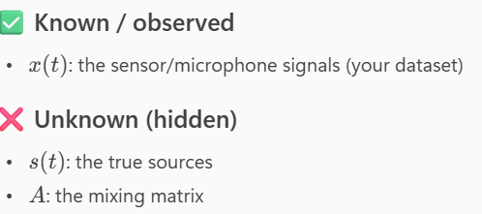
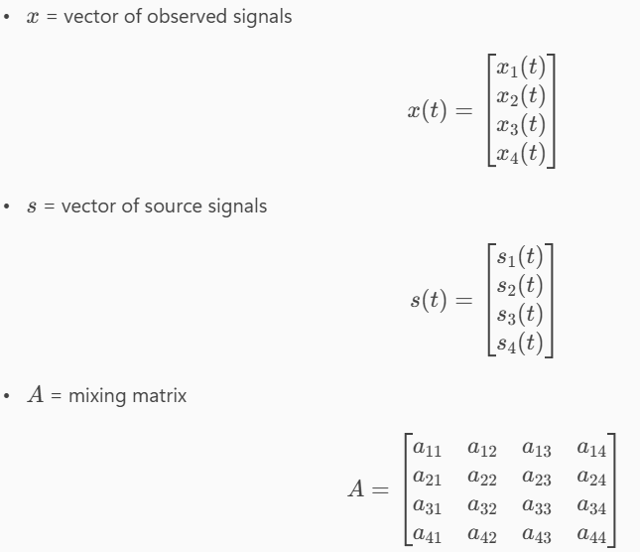
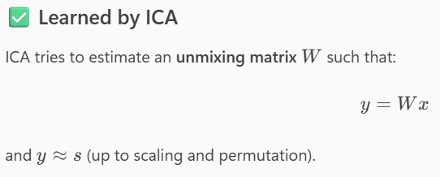

Slide 9
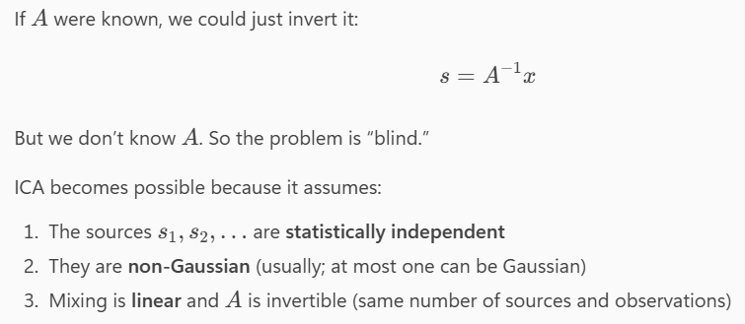
Notes:
ICA works because it uses independence as a powerful clue. It searches for a transformation that makes the outputs as independent as possible

Slide 10
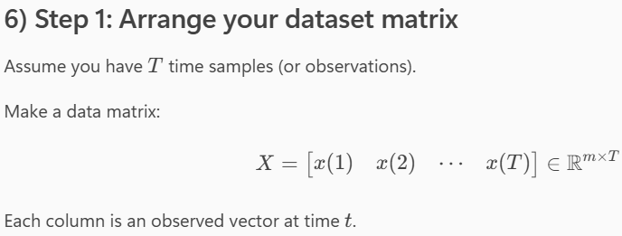
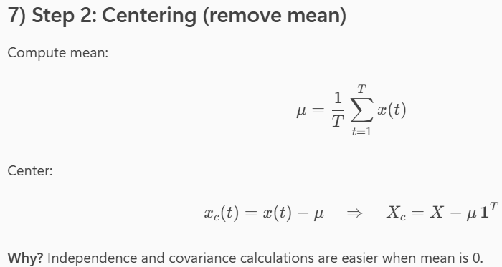
Notes:
Because covariance and ICA objectives are cleaner when the mean is zero

Slide 11
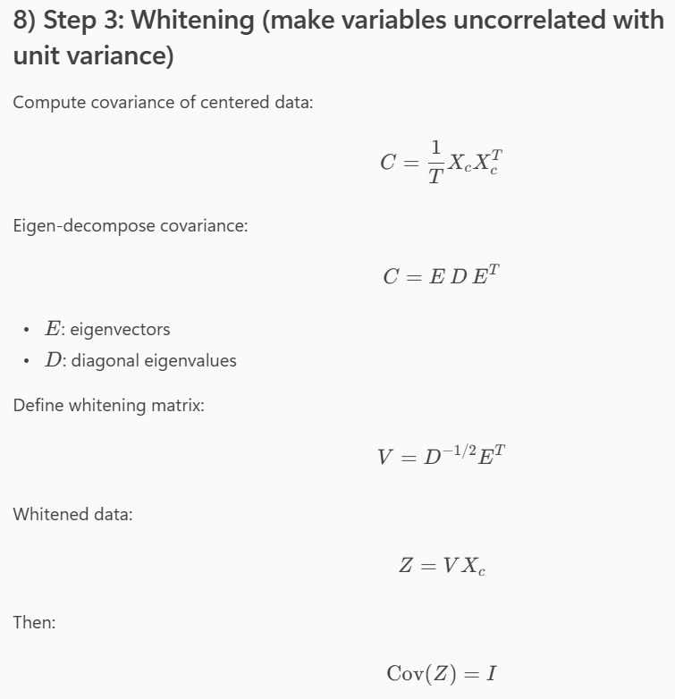

Notes:
Xc​XcT​ is an $m×m$matrix.
Entry $\left(i , j\right)$equals the average product of sensor $i$and sensor $j$after centering:
large positive ⇒ they move together
negative ⇒ opposite
near 0 ⇒ not linearly related
So $C$summarizes how the observed signals are correlated.
E: matrix of eigenvectors (orthonormal directions)
$D$: diagonal matrix of eigenvalues (variances along those directions)
Interpretation (simple):
This rewrites the covariance in a coordinate system where it becomes diagonal — meaning the variables become uncorrelated in that new basis.
V=D−1/2ET
Rotate into the eigenvector basis: $E^{T}$
Scale each rotated axis so its variance becomes 1: $D^{−1/2}$
Because:
if variance along an eigen-direction is $λ$,
dividing by $\sqrt{λ}$makes variance become 1.
So $D^{−1/2}$is literally “divide by standard deviation in each eigen-direction”.
Z=VXc​
So we take centered data $X_{c}$and apply whitening transform $V$.
Cov(Z)=I
Cov(Z)=T1​ZZT
Substitute $Z=VX_{c}$:
$$\text{Cov}\left(Z\right)=\frac{1}{T}\left(VX_{c}\right)\left(VX_{c}{\left.)\right.}^{T}\right.$$
$$=\frac{1}{T}VX_{c}X_{c}^{T}V^{T}$$
But $\frac{1}{T}X_{c}X_{c}^{T}=C$, so:
$$\text{Cov}\left(Z\right)=VCV^{T}$$
Now substitute $C=EDE^{T}$and $V=D^{−1/2}E^{T}$.
First compute $VCV^{T}$:
$$VCV^{T}=\left(D^{−1/2}E^{T}\right)\left(EDE^{T}\right)\left(ED^{−1/2}\right)$$
Use $E^{T}E=I$and $EE^{T}=I$:
$$=D^{−1/2}\left(E^{T}E\right)D\left(E^{T}E\right)D^{−1/2}$$
$$=D^{−1/2}DD^{−1/2}$$
$$=I$$
✅ Done.
So whitening guarantees the transformed variables are:
zero mean (because $X_{c}$was centered)
uncorrelated
unit variance

Slide 12
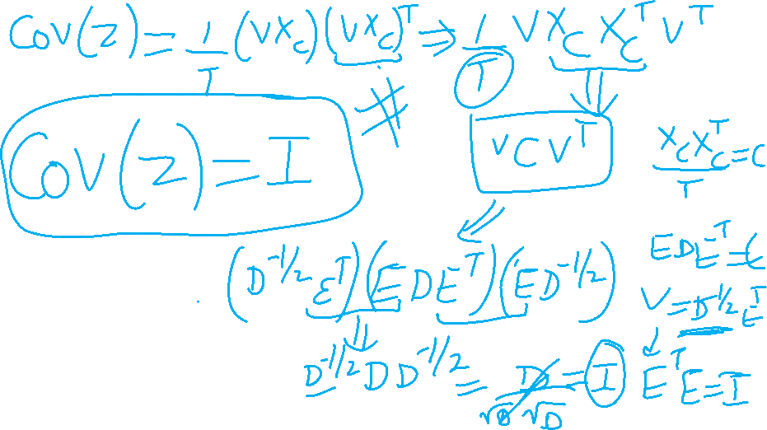

Slide 13
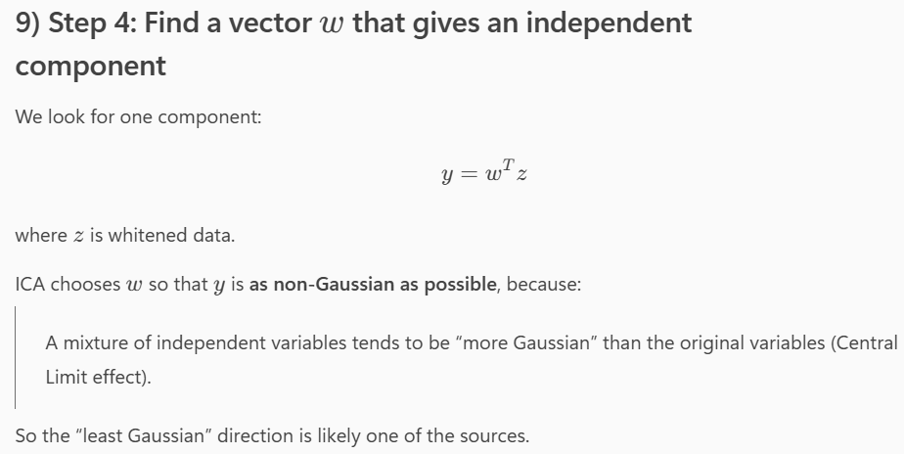
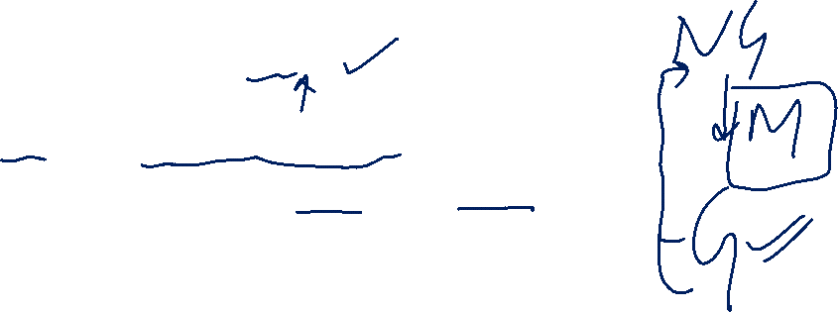
Notes:
ICA assumes our observed signals are linear mixtures of hidden independent sources: $x=As$. We only observe $x$, while both $A$and $s$are unknown. ICA learns an unmixing matrix $W$so that $y=Wx$gives us signals that are as independent as possible—these $y$’s approximate the original sources, up to scaling and ordering. In practice ICA is done in three steps: first we center the data, then we whiten it so covariance becomes identity, and finally we find a rotation that maximizes non‑Gaussianity or independence of the outputs. FastICA is a common algorithm for this
Central Limit intuition)
“Mixtures of independent signals look more Gaussian than the original signals.”
So if we try many directions (many $w$’s) and look at:
the directions that produce the most non‑Gaussian output tend to align with the original sources.
Find directions $w$such that $w^{T}z$is maximally non‑Gaussian (or equivalently, maximally independent).
This is why ICA often talks about:
non‑Gaussianity
negentropy
kurtosis
FastICA

Slide 14
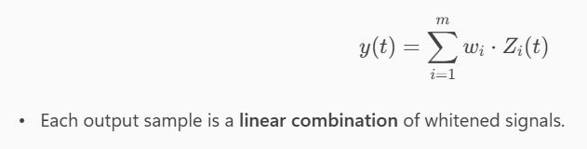
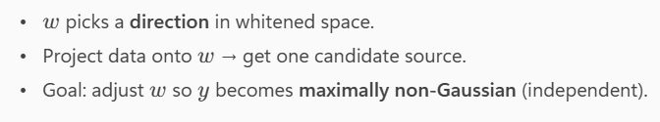
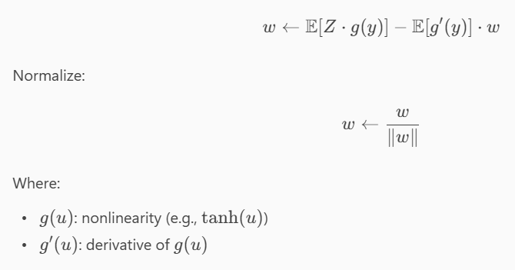

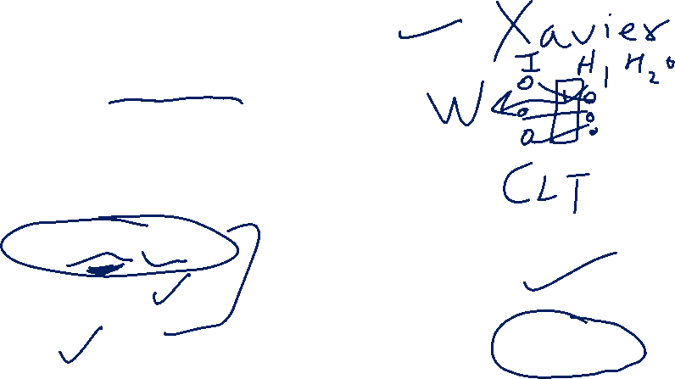
Notes:
Remember: we already converted our observed data into whitened signals $z_{1}\left(t\right),z_{2}\left(t\right),…,z_{m}\left(t\right)$. Whitening means they are zero-mean, uncorrelated, and have unit variance. So the easy part—correlation and scaling—is removed.
“On the top, the equation says:
$$y\left(t\right)=\sum_{i=1}^{m}{w_{i}} z_{i}\left(t\right)$$
This simply means: at each time $t$, the output $y\left(t\right)$is a linear combination of the whitened signals.
In vector form, this is the same as:
$$y\left(t\right)=w^{T}z\left(t\right)$$
So you can think of $w$as a direction in whitened space.”
“So what are we doing conceptually?
We choose a direction $w$, we project the data onto that direction, and we get one candidate signal $y\left(t\right)$. That candidate is ‘our guess’ for one hidden source.”
“Now the key question: how do we choose the right $w$?
ICA says: adjust $w$so that $y$becomes maximally non-Gaussian, because mixtures of independent sources tend to look more Gaussian than the original sources.
So the ‘most non-Gaussian’ projection is likely to correspond to a true independent component.”
“That’s why we use this update rule here:
$$w←𝔼\left[z g\left(y\right)\right]−𝔼\left[g^{′}\left(y\right)\right] w$$
Don’t get scared by the notation. The meaning is simple:
First we compute the current output $y=w^{T}z$.
Then we apply a nonlinearity $g\left(⋅\right)$, commonly something like $tanh⁡\left(⋅\right)$.
The term $𝔼\left[z g\left(y\right)\right]$pushes $w$toward directions that increase non-Gaussianity.
The term $𝔼\left[g^{′}\left(y\right)\right] w$is a correction term that stabilizes the update and prevents trivial solutions.”
“After updating $w$, we normalize it:
$$w←\frac{w}{∥w∥}$$
This is important because if we let the length of $w$grow, $y$would grow just by scaling, and the algorithm could ‘cheat’. Normalization ensures we care only about the direction, not the magnitude.”
“Finally, we repeat these steps until convergence. The stopping condition written here is:
$$∣w_{\text{new}}^{T}w_{\text{old}}∣≈1$$
This means the new direction is almost the same as the old direction—so we stop when $w$is no longer changing.
The absolute value is used because $w$and $−w$represent the same component; sign doesn’t matter.”
“So summarizing this slide in one line:
Pick a direction $w$, project to get $y$, update $w$to make $y$as non-Gaussian as possible, normalize, and repeat until $w$stops changing.
That gives us one independent component.”

Slide 15

Application domains of ICA
Blind source separation
Image denoising
Medical signal processing – fMRI, ECG, EEG
Modelling of the hippocampus and visual cortex
Feature extraction, face recognition
Compression, redundancy reduction
Watermarking
Clustering
Time series analysis (stock market, microarray data)
Topic extraction
Econometrics: Finding hidden factors in financial data

Slide 16

Approaches to ICA
Unsupervised Learning
  Factorial coding (Minimum entropy coding, Redundancy reduction)
  Maximum likelihood learning
  Nonlinear information maximization (entropy maximization)
  Negentropy maximization
  Bayesian learning
Statistical Signal Processing
  Higher-order moments or cumulants
  Joint approximate diagonalization
  Maximum likelihood estimation
Notes:
Concept/Gist: ICA separates mixed signals into statistically independent sources.

Slide 17
APPENDIX
Notes:
Optional / Backup
Slide 194/224 — APPENDIX
Concept/Gist: Math appendix—use only if someone asks for derivations.
Say this (teacher-style):
Explain the idea in one sentence, then give a quick automotive example, then move on.
Don’t read bullets—use them as keywords.
Tata Motors example: Example: compress high-dimensional features to make downstream models faster, more robust, and easier to interpret.
Engage: Quick ask: What would be the most useful 2D visualization you could get from your high-dimensional data?
Delivery tip: SKIP in live session; keep as backup for Q&A.

Slide 18
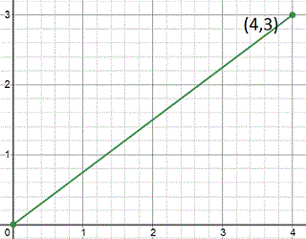

PCA : Some Mathematics
Scalar: Scalar is nothing but a number with a value. e.g. 5 is a scalar, 2.45 is a scalar.
Vector: Vector can be thought of an object with a magnitude and a direction. A coordinate can in two dimension is an example of a vector. e.g. (4,3).
Notes:
Optional / Backup
Slide 195/224 — 195
Concept/Gist: Math appendix—use only if someone asks for derivations.
Say this (teacher-style):
Treat this as a picture-based intuition slide. Describe what it illustrates in one sentence, then state the takeaway.
Relate it back to ‘compress + denoise + visualize’.
Tata Motors example: Example: compress high-dimensional features to make downstream models faster, more robust, and easier to interpret.
Engage: Quick ask: What would be the most useful 2D visualization you could get from your high-dimensional data?
Delivery tip: SKIP in live session; keep as backup for Q&A.

Slide 19
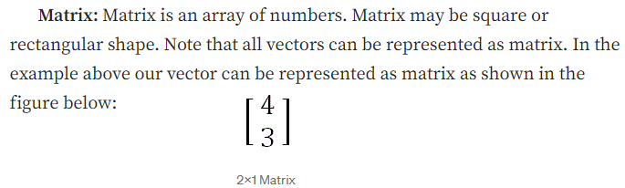
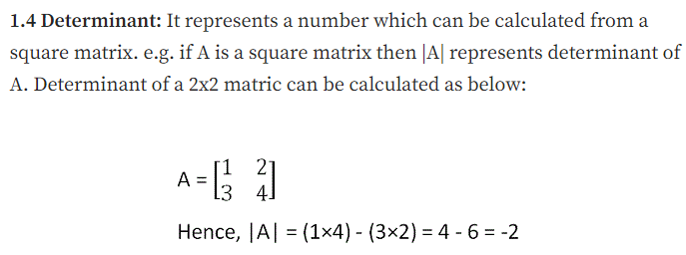
PCA: Some Mathematics
Notes:
Optional / Backup
Slide 196/224 — 196
Concept/Gist: Math appendix—use only if someone asks for derivations.
Say this (teacher-style):
Treat this as a picture-based intuition slide. Describe what it illustrates in one sentence, then state the takeaway.
Relate it back to ‘compress + denoise + visualize’.
Tata Motors example: Example: compress high-dimensional features to make downstream models faster, more robust, and easier to interpret.
Engage: Quick ask: What would be the most useful 2D visualization you could get from your high-dimensional data?
Delivery tip: SKIP in live session; keep as backup for Q&A.

Slide 20
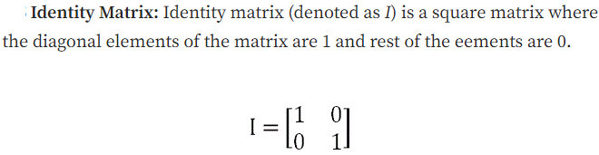
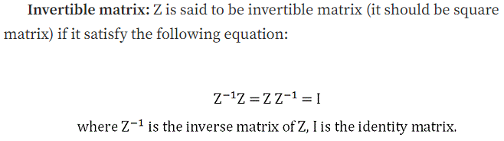
PCA: Some Mathematics
Notes:
Optional / Backup
Slide 197/224 — 197
Concept/Gist: Math appendix—use only if someone asks for derivations.
Say this (teacher-style):
Treat this as a picture-based intuition slide. Describe what it illustrates in one sentence, then state the takeaway.
Relate it back to ‘compress + denoise + visualize’.
Tata Motors example: Example: compress high-dimensional features to make downstream models faster, more robust, and easier to interpret.
Engage: Quick ask: What would be the most useful 2D visualization you could get from your high-dimensional data?
Delivery tip: SKIP in live session; keep as backup for Q&A.

Slide 21
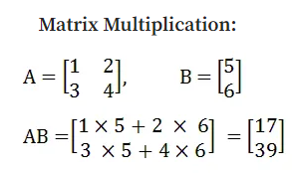
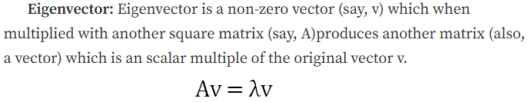
PCA: Some Mathematics
Notes:
Optional / Backup
Slide 198/224 — 198
Concept/Gist: Math appendix—use only if someone asks for derivations.
Say this (teacher-style):
Treat this as a picture-based intuition slide. Describe what it illustrates in one sentence, then state the takeaway.
Relate it back to ‘compress + denoise + visualize’.
Tata Motors example: Example: compress high-dimensional features to make downstream models faster, more robust, and easier to interpret.
Engage: Quick ask: What would be the most useful 2D visualization you could get from your high-dimensional data?
Delivery tip: SKIP in live session; keep as backup for Q&A.

Slide 22
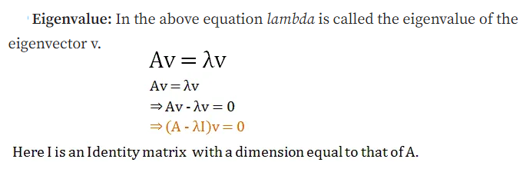
PCA: Some Mathematics
Notes:
Optional / Backup
Slide 199/224 — 199
Concept/Gist: Math appendix—use only if someone asks for derivations.
Say this (teacher-style):
Treat this as a picture-based intuition slide. Describe what it illustrates in one sentence, then state the takeaway.
Relate it back to ‘compress + denoise + visualize’.
Tata Motors example: Example: compress high-dimensional features to make downstream models faster, more robust, and easier to interpret.
Engage: Quick ask: What would be the most useful 2D visualization you could get from your high-dimensional data?
Delivery tip: SKIP in live session; keep as backup for Q&A.

Slide 23
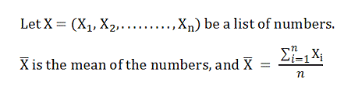
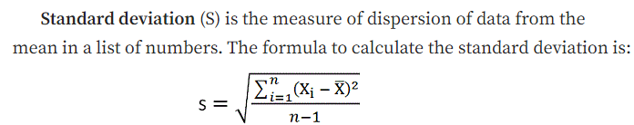
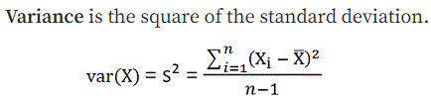
PCA: Some Statistics
Notes:
Optional / Backup
Slide 200/224 — 200
Concept/Gist: Math appendix—use only if someone asks for derivations.
Say this (teacher-style):
Treat this as a picture-based intuition slide. Describe what it illustrates in one sentence, then state the takeaway.
Relate it back to ‘compress + denoise + visualize’.
Tata Motors example: Example: compress high-dimensional features to make downstream models faster, more robust, and easier to interpret.
Engage: Quick ask: What would be the most useful 2D visualization you could get from your high-dimensional data?
Delivery tip: SKIP in live session; keep as backup for Q&A.

Slide 24
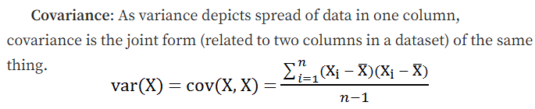

PCA: Some Mathematics
Notes:
Optional / Backup
Slide 201/224 — 201
Concept/Gist: Math appendix—use only if someone asks for derivations.
Say this (teacher-style):
Treat this as a picture-based intuition slide. Describe what it illustrates in one sentence, then state the takeaway.
Relate it back to ‘compress + denoise + visualize’.
Tata Motors example: Example: compress high-dimensional features to make downstream models faster, more robust, and easier to interpret.
Engage: Quick ask: What would be the most useful 2D visualization you could get from your high-dimensional data?
Delivery tip: SKIP in live session; keep as backup for Q&A.

Slide 25
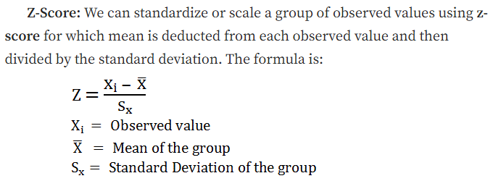
PCA: Some Mathematics
Notes:
Optional / Backup
Slide 202/224 — 202
Concept/Gist: Math appendix—use only if someone asks for derivations.
Say this (teacher-style):
Treat this as a picture-based intuition slide. Describe what it illustrates in one sentence, then state the takeaway.
Relate it back to ‘compress + denoise + visualize’.
Tata Motors example: Example: compress high-dimensional features to make downstream models faster, more robust, and easier to interpret.
Engage: Quick ask: What would be the most useful 2D visualization you could get from your high-dimensional data?
Delivery tip: SKIP in live session; keep as backup for Q&A.

Slide 26
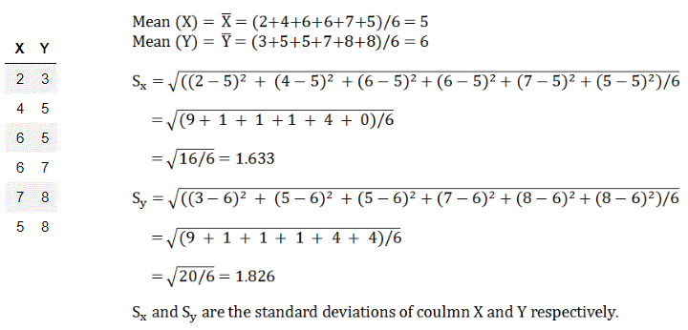
PCA: Some Mathematics
Notes:
Optional / Backup
Slide 203/224 — 203
Concept/Gist: Math appendix—use only if someone asks for derivations.
Say this (teacher-style):
Treat this as a picture-based intuition slide. Describe what it illustrates in one sentence, then state the takeaway.
Relate it back to ‘compress + denoise + visualize’.
Tata Motors example: Example: compress high-dimensional features to make downstream models faster, more robust, and easier to interpret.
Engage: Quick ask: What would be the most useful 2D visualization you could get from your high-dimensional data?
Delivery tip: SKIP in live session; keep as backup for Q&A.

Slide 27
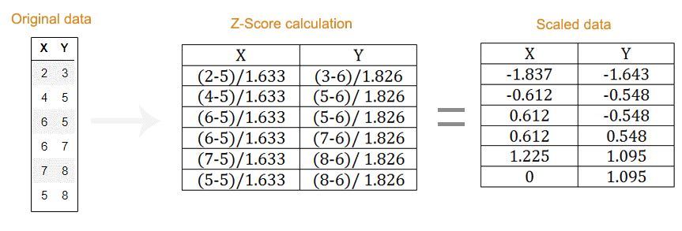
PCA: Some Mathematics
Notes:
Optional / Backup
Slide 204/224 — 204
Concept/Gist: Math appendix—use only if someone asks for derivations.
Say this (teacher-style):
Treat this as a picture-based intuition slide. Describe what it illustrates in one sentence, then state the takeaway.
Relate it back to ‘compress + denoise + visualize’.
Tata Motors example: Example: compress high-dimensional features to make downstream models faster, more robust, and easier to interpret.
Engage: Quick ask: What would be the most useful 2D visualization you could get from your high-dimensional data?
Delivery tip: SKIP in live session; keep as backup for Q&A.

Slide 28
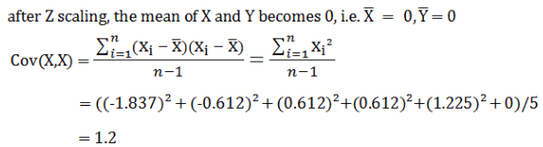
PCA: Some Mathematics
Notes:
Optional / Backup
Slide 205/224 — 205
Concept/Gist: Math appendix—use only if someone asks for derivations.
Say this (teacher-style):
Treat this as a picture-based intuition slide. Describe what it illustrates in one sentence, then state the takeaway.
Relate it back to ‘compress + denoise + visualize’.
Tata Motors example: Example: compress high-dimensional features to make downstream models faster, more robust, and easier to interpret.
Engage: Quick ask: What would be the most useful 2D visualization you could get from your high-dimensional data?
Delivery tip: SKIP in live session; keep as backup for Q&A.

Slide 29
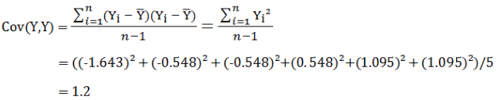
PCA: Some Mathematics
Notes:
Optional / Backup
Slide 206/224 — 206
Concept/Gist: Math appendix—use only if someone asks for derivations.
Say this (teacher-style):
Treat this as a picture-based intuition slide. Describe what it illustrates in one sentence, then state the takeaway.
Relate it back to ‘compress + denoise + visualize’.
Tata Motors example: Example: compress high-dimensional features to make downstream models faster, more robust, and easier to interpret.
Engage: Quick ask: What would be the most useful 2D visualization you could get from your high-dimensional data?
Delivery tip: SKIP in live session; keep as backup for Q&A.

Slide 30
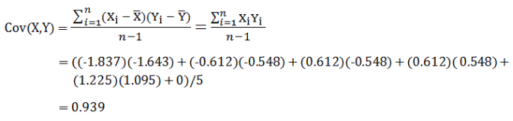
PCA: Some Mathematics
Notes:
Optional / Backup
Slide 207/224 — 207
Concept/Gist: Math appendix—use only if someone asks for derivations.
Say this (teacher-style):
Treat this as a picture-based intuition slide. Describe what it illustrates in one sentence, then state the takeaway.
Relate it back to ‘compress + denoise + visualize’.
Tata Motors example: Example: compress high-dimensional features to make downstream models faster, more robust, and easier to interpret.
Engage: Quick ask: What would be the most useful 2D visualization you could get from your high-dimensional data?
Delivery tip: SKIP in live session; keep as backup for Q&A.

Slide 31
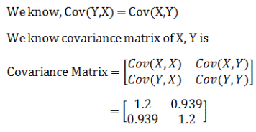
PCA: Some Mathematics
Notes:
Optional / Backup
Slide 208/224 — 208
Concept/Gist: Math appendix—use only if someone asks for derivations.
Say this (teacher-style):
Treat this as a picture-based intuition slide. Describe what it illustrates in one sentence, then state the takeaway.
Relate it back to ‘compress + denoise + visualize’.
Tata Motors example: Example: compress high-dimensional features to make downstream models faster, more robust, and easier to interpret.
Engage: Quick ask: What would be the most useful 2D visualization you could get from your high-dimensional data?
Delivery tip: SKIP in live session; keep as backup for Q&A.

Slide 32
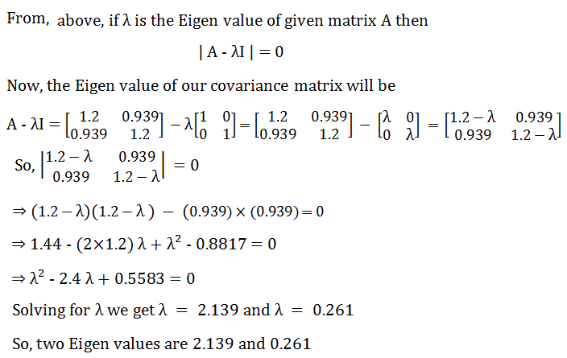
PCA: Some Mathematics
Notes:
Optional / Backup
Slide 209/224 — 209
Concept/Gist: Math appendix—use only if someone asks for derivations.
Say this (teacher-style):
Treat this as a picture-based intuition slide. Describe what it illustrates in one sentence, then state the takeaway.
Relate it back to ‘compress + denoise + visualize’.
Tata Motors example: Example: compress high-dimensional features to make downstream models faster, more robust, and easier to interpret.
Engage: Quick ask: What would be the most useful 2D visualization you could get from your high-dimensional data?
Delivery tip: SKIP in live session; keep as backup for Q&A.

Slide 33
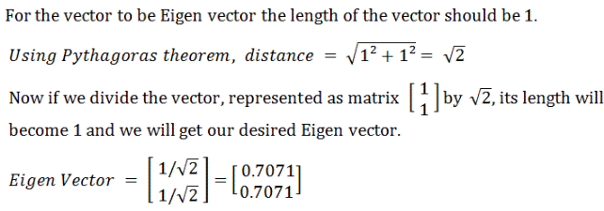
PCA: Some Mathematics
Notes:
Optional / Backup
Slide 210/224 — 210
Concept/Gist: Math appendix—use only if someone asks for derivations.
Say this (teacher-style):
Treat this as a picture-based intuition slide. Describe what it illustrates in one sentence, then state the takeaway.
Relate it back to ‘compress + denoise + visualize’.
Tata Motors example: Example: compress high-dimensional features to make downstream models faster, more robust, and easier to interpret.
Engage: Quick ask: What would be the most useful 2D visualization you could get from your high-dimensional data?
Delivery tip: SKIP in live session; keep as backup for Q&A.

Slide 34
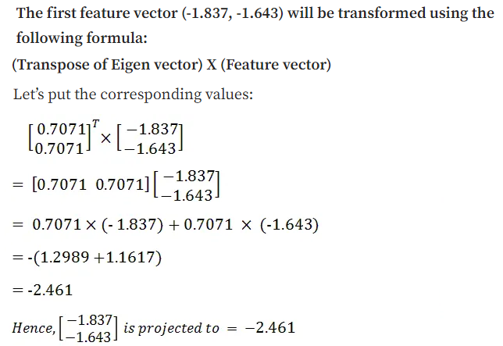
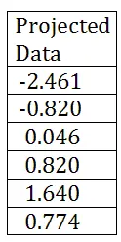
PCA: Some Mathematics
Notes:
Optional / Backup
Slide 211/224 — 211
Concept/Gist: Math appendix—use only if someone asks for derivations.
Say this (teacher-style):
Treat this as a picture-based intuition slide. Describe what it illustrates in one sentence, then state the takeaway.
Relate it back to ‘compress + denoise + visualize’.
Tata Motors example: Example: compress high-dimensional features to make downstream models faster, more robust, and easier to interpret.
Engage: Quick ask: What would be the most useful 2D visualization you could get from your high-dimensional data?
Delivery tip: SKIP in live session; keep as backup for Q&A.

Slide 35
Eigenvector and Eigenvalue
Ax = λx
A: Square Matrix
λ: Eigenvector or characteristic vector
X: Eigenvalue or characteristic value
The zero vector can not be an eigenvector
The value zero can be eigenvalue
Notes:
Optional / Backup
Slide 212/224 — Eigenvector and Eigenvalue
Concept/Gist: Math appendix—use only if someone asks for derivations.
Say this (teacher-style):
Explain the idea in one sentence, then give a quick automotive example, then move on.
Don’t read bullets—use them as keywords.
Tata Motors example: Example: compress high-dimensional features to make downstream models faster, more robust, and easier to interpret.
Engage: Quick ask: What would be the most useful 2D visualization you could get from your high-dimensional data?
Delivery tip: SKIP in live session; keep as backup for Q&A.

Slide 36
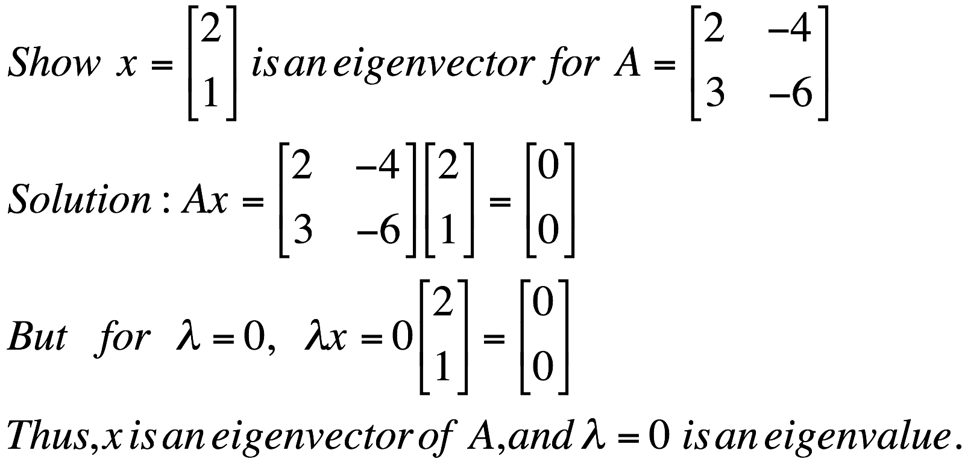
Eigenvector and Eigenvalue
Ax = λx
A: Square Matrix
λ: Eigenvector or characteristic vector
X: Eigenvalue or characteristic value
Example
Notes:
Optional / Backup
Slide 213/224 — Ax = λx
Concept/Gist: Math appendix—use only if someone asks for derivations.
Say this (teacher-style):
Explain the idea in one sentence, then give a quick automotive example, then move on.
Don’t read bullets—use them as keywords.
Tata Motors example: Example: compress high-dimensional features to make downstream models faster, more robust, and easier to interpret.
Engage: Quick ask: What would be the most useful 2D visualization you could get from your high-dimensional data?
Delivery tip: SKIP in live session; keep as backup for Q&A.

Slide 37

Eigenvector and Eigenvalue
Ax - λx = 0
(A – λI)x = 0
Ax = λx
B = A – λI
Bx = 0
If we define a new matrix B:
BUT! an eigenvector cannot be zero!!
If B has an inverse:
x = B⁻¹0 = 0
x will be an eigenvector of A if and only if B does not have an inverse, or equivalently det(B)=0 :
det(A – λI) = 0
Notes:
Optional / Backup
Slide 214/224 — Ax - λx = 0
Concept/Gist: Math appendix—use only if someone asks for derivations.
Say this (teacher-style):
Translate the equation into plain English: what is being maximized/minimized, and what constraint keeps the solution well-behaved.
Then give the one practical takeaway: eigenvalues rank importance; vectors define the new coordinates.
Tata Motors example: Example: compress high-dimensional features to make downstream models faster, more robust, and easier to interpret.
Engage: Quick ask: What would be the most useful 2D visualization you could get from your high-dimensional data?
Delivery tip: SKIP in live session; keep as backup for Q&A.

Slide 38
Eigenvector and Eigenvalue
Example 1: Find the eigenvalues of
two eigenvalues: −1, − 2
Note: The roots of the characteristic equation can be repeated. That is, λ₁ = λ₂ =…= λ_{k}. If that happens, the eigenvalue is said to be of multiplicity k.
Example 2: Find the eigenvalues of
λ = 2 is an eigenvector of multiplicity 3.
Notes:
Optional / Backup
Slide 215/224 — Example 1: Find the eigenvalues of
Concept/Gist: Math appendix—use only if someone asks for derivations.
Say this (teacher-style):
Choosing K components is like choosing how many summary needles your dashboard needs.
Keep too few and you lose important behavior; keep too many and you keep noise.
Rule of thumb: pick K by explained variance *and* by downstream performance (accuracy, clustering quality, anomaly separation).
Tata Motors example: Example: compress high-dimensional features to make downstream models faster, more robust, and easier to interpret.
Engage: Quick ask: What would be the most useful 2D visualization you could get from your high-dimensional data?
Delivery tip: SKIP in live session; keep as backup for Q&A.

Slide 39
PCA: one attribute first
Temperature
42
40
24
30
15
18
15
30
15
30
35
30
40
30
Question: how much spread is in the data along the axis? (distance to the mean)
Variance=Standard deviation^2
Notes:
Optional / Backup
Slide 216/224 — Question: how much spread is in the data along the axis? (distance to the mean)
Concept/Gist: Math appendix—use only if someone asks for derivations.
Say this (teacher-style):
Explain the idea in one sentence, then give a quick automotive example, then move on.
Don’t read bullets—use them as keywords.
Tata Motors example: Example: compress high-dimensional features to make downstream models faster, more robust, and easier to interpret.
Engage: Quick ask: What would be the most useful 2D visualization you could get from your high-dimensional data?
Delivery tip: SKIP in live session; keep as backup for Q&A.

Slide 40
Now consider two dimensions
Covariance: measures the
correlation between X and Y
Cov(X,Y)=0: independent
Cov(X,Y)>0: move same dir
Cov(X,Y)<0: move oppo dir
X=Temperature | Y=Humidity
40 | 90
40 | 90
40 | 90
30 | 90
15 | 70
15 | 70
15 | 70
30 | 90
15 | 70
30 | 70
30 | 70
30 | 90
40 | 70
30 | 90
Notes:
Optional / Backup
Slide 217/224 — 217
Concept/Gist: Math appendix—use only if someone asks for derivations.
Say this (teacher-style):
Explain the idea in one sentence, then give a quick automotive example, then move on.
Don’t read bullets—use them as keywords.
Tata Motors example: Example: compress high-dimensional features to make downstream models faster, more robust, and easier to interpret.
Engage: Quick ask: What would be the most useful 2D visualization you could get from your high-dimensional data?
Delivery tip: SKIP in live session; keep as backup for Q&A.

Slide 41
More than two attributes: covariance matrix
Contains covariance values between all possible dimensions (=attributes):
Example for three attributes (x,y,z):
Notes:
Optional / Backup
Slide 218/224 — Contains covariance values between all possible dimensions (=attributes):
Concept/Gist: Math appendix—use only if someone asks for derivations.
Say this (teacher-style):
Covariance answers: do two variables ‘dance together’?
Positive covariance means they rise/fall together; negative means one rises when the other falls; near-zero means no linear relation.
PCA starts by building the covariance matrix—basically a scoreboard of how every pair moves together.
Tata Motors example: Example: compress high-dimensional features to make downstream models faster, more robust, and easier to interpret.
Engage: Quick ask: What would be the most useful 2D visualization you could get from your high-dimensional data?
Delivery tip: SKIP in live session; keep as backup for Q&A.

Slide 42
Transformed Data
Eigenvalues λ_{j} corresponds to variance on each component j
Thus, sort by λ_{j}
Take the first p eigenvectors e_{i;} where p is the number of top eigenvalues
These are the directions with the largest variances
Notes:
Optional / Backup
Slide 219/224 — 219
Concept/Gist: Math appendix—use only if someone asks for derivations.
Say this (teacher-style):
Explain the idea in one sentence, then give a quick automotive example, then move on.
Don’t read bullets—use them as keywords.
Tata Motors example: Example: compress high-dimensional features to make downstream models faster, more robust, and easier to interpret.
Engage: Quick ask: What would be the most useful 2D visualization you could get from your high-dimensional data?
Delivery tip: SKIP in live session; keep as backup for Q&A.

Slide 43
Eigenvalues & eigenvectors
Vectors x having same direction as Ax are called eigenvectors of A (A is an n by n matrix).
In the equation Ax=λx, λ is called an eigenvalue of A.
Notes:
Optional / Backup
Slide 220/224 — Vectors x having same direction as Ax are called eigenvectors of A (A is an n by n matrix).
Concept/Gist: Math appendix—use only if someone asks for derivations.
Say this (teacher-style):
Explain the idea in one sentence, then give a quick automotive example, then move on.
Don’t read bullets—use them as keywords.
Tata Motors example: Example: compress high-dimensional features to make downstream models faster, more robust, and easier to interpret.
Engage: Quick ask: What would be the most useful 2D visualization you could get from your high-dimensional data?
Delivery tip: SKIP in live session; keep as backup for Q&A.

Slide 44
Eigenvalues & eigenvectors
Ax=λx ⇔ (A-λI)x=0
How to calculate x and λ:
  Calculate det(A-λI), yields a polynomial (degree n)
  Determine roots to det(A-λI)=0, roots are eigenvalues λ
  Solve (A- λI) x=0 for each λ to obtain eigenvectors x
Notes:
Optional / Backup
Slide 221/224 — Ax=x  (A-I)x=0
Concept/Gist: Math appendix—use only if someone asks for derivations.
Say this (teacher-style):
Translate the equation into plain English: what is being maximized/minimized, and what constraint keeps the solution well-behaved.
Then give the one practical takeaway: eigenvalues rank importance; vectors define the new coordinates.
Tata Motors example: Example: compress high-dimensional features to make downstream models faster, more robust, and easier to interpret.
Engage: Quick ask: What would be the most useful 2D visualization you could get from your high-dimensional data?
Delivery tip: SKIP in live session; keep as backup for Q&A.

Slide 45
PCA
1. principal component (PC1)
  The eigenvalue with the largest absolute value will indicate that the data have the largest variance along its eigenvector, the direction along which there is greatest variation
2. principal component (PC2)
  the direction with maximum variation left in data, orthogonal to the 1. PC
In general, only few directions manage to capture most of the variability in the data.
Notes:
Optional / Backup
Slide 222/224 — 1. principal component (PC1)
Concept/Gist: Math appendix—use only if someone asks for derivations.
Say this (teacher-style):
Explain the idea in one sentence, then give a quick automotive example, then move on.
Don’t read bullets—use them as keywords.
Tata Motors example: Example: compress high-dimensional features to make downstream models faster, more robust, and easier to interpret.
Engage: Quick ask: What would be the most useful 2D visualization you could get from your high-dimensional data?
Delivery tip: SKIP in live session; keep as backup for Q&A.

Slide 46
Steps of PCA
Let be the mean vector (taking the mean of all rows)
Adjust the original data by the mean
  X’ = X –
Compute the covariance matrix C of adjusted X
Find the eigenvectors and eigenvalues of C.
For matrix C, vectors e (=column vector) having same direction as Ce :
  eigenvectors of C is e such that Ce=λe,
  λ is called an eigenvalue of C.
Ce=λe ⇔ (C-λI)e=0
  Most data mining packages do this for you.
Notes:
Optional / Backup
Slide 223/224 — Let be the mean vector (taking the mean of all rows)
Concept/Gist: Math appendix—use only if someone asks for derivations.
Say this (teacher-style):
Explain the idea in one sentence, then give a quick automotive example, then move on.
Don’t read bullets—use them as keywords.
Tata Motors example: Example: compress high-dimensional features to make downstream models faster, more robust, and easier to interpret.
Engage: Quick ask: What would be the most useful 2D visualization you could get from your high-dimensional data?
Delivery tip: SKIP in live session; keep as backup for Q&A.

Slide 47
Eigenvalues
Calculate eigenvalues λ and eigenvectors x for covariance matrix:
  Eigenvalues λ_{j} are used for calculation of [% of total variance] (V_{j}) for each component j:
Notes:
Optional / Backup
Slide 224/224 — Calculate eigenvalues  and eigenvectors x for covariance matrix:
Concept/Gist: Math appendix—use only if someone asks for derivations.
Say this (teacher-style):
Covariance answers: do two variables ‘dance together’?
Positive covariance means they rise/fall together; negative means one rises when the other falls; near-zero means no linear relation.
PCA starts by building the covariance matrix—basically a scoreboard of how every pair moves together.
Tata Motors example: Example: compress high-dimensional features to make downstream models faster, more robust, and easier to interpret.
Engage: Quick ask: What would be the most useful 2D visualization you could get from your high-dimensional data?
Delivery tip: SKIP in live session; keep as backup for Q&A.

